Slide 1
WO3196 Light and Dark
Discovered last week that closing the window increased the resistance, so the light is influencing the resistance and should be eliminated
But first it should be measured
Folder: 20200124 WO3196 Dark light and ohmic IV

Slide 2
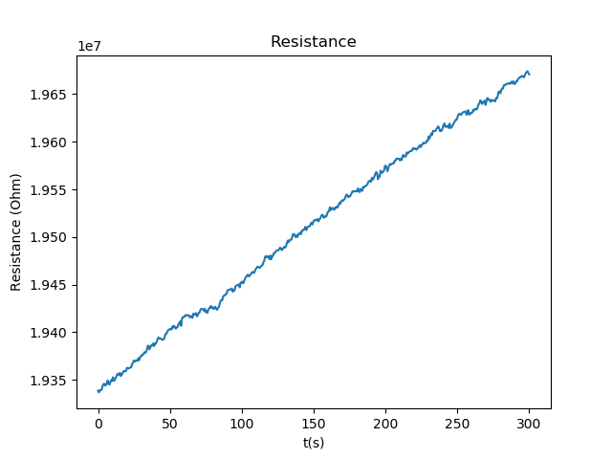
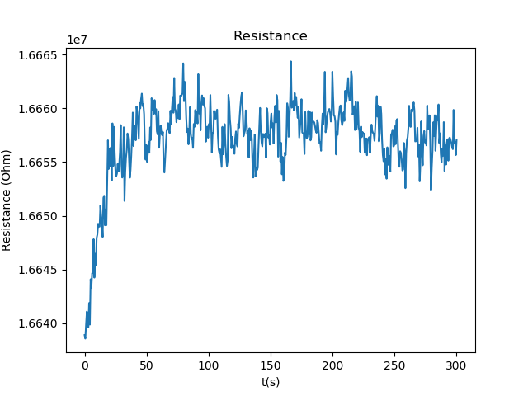
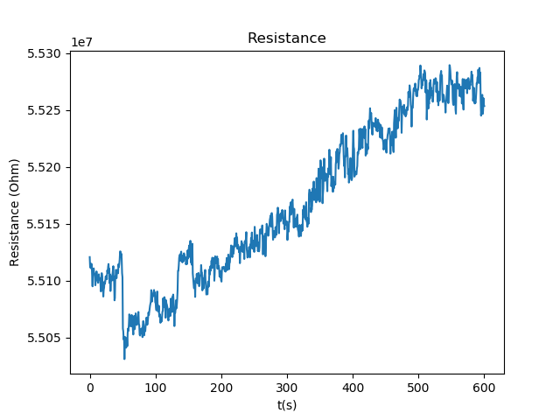
Stability (light and dark)
Dark
Light

Slide 3
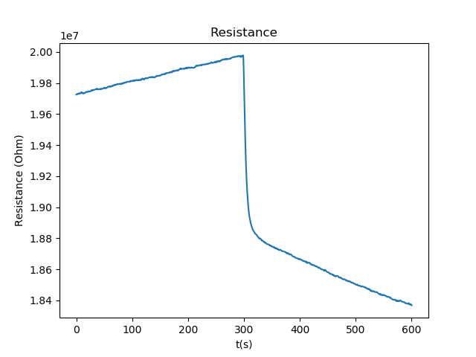
Dark to Light
Dark after an hour
Opened the window around 5 min in (300s)
Dark to light
Initial resistance is not as high as it can be as when the window was replaced by a metal plate, the resistance was around 5e7, instead of 2e7 Ohm
But the change in resistance is still very clear showing that the sample is susceptible to outside light

Slide 4
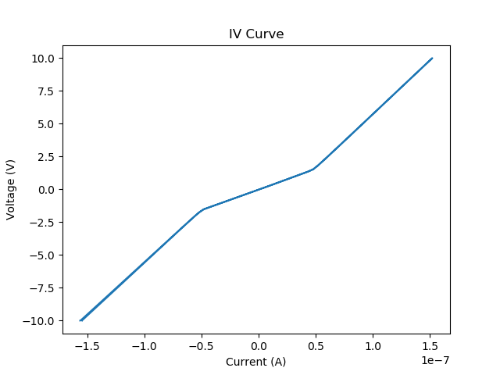
Dark IV curve
Dark IV curve
Has kinks round +/-0.5e-7 A and +/-1.5 V

Slide 5
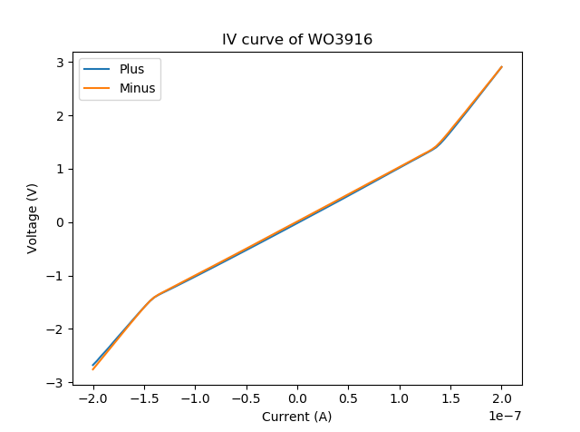
IV curve Dark and Light
Dark
Light
0.5e-7 A and 1.5 V
1.5E-7 A and 1.5 V

